Slide 1


Ellipsis Hackathon 2022
Ellipsis Hackathon 2022
Team XADEX
Notes:
Here is team XADEX’s submission for the Ellipsis Hackathon

Slide 2
1. Problem Statement
Problems of Compliance Process for Fintech Companies
Compliance is a indispensable process for companies offering financial services.
Yet, compliance can also be immensely overwhelming and challenging for companies like fintech startups.
1. Tedious & Error-prone
Regulations for fintech companies are constantly updating across various geographical regions and business sectors.
Regular monitoring by staff with sufficient expertise entails huge financial costs.
Prolonged operational time is also undesirable in this competitive market where speed can be pivotal. Non-compliance can be detrimental for fintech companies: fines, penalties, and loss of consumer base can significantly cripple operations and growth.
2. Huge Financial & Time Costs
Notes:
This is a daily operational occurrence but increases in call complexity related to changes in the knowledge base – multiple programs and changes in the environment (client demographics and needs/circumstances, legislation, etc.) – have resulted in an increase in severity and stress on the system.

Slide 3
2. Addressable Market
Our proposed model was created with these addressable markets in mind:
Note: as Annual Contract Value (ACV) is outside the scope of this project it will not be calculated. Furthermore, SOM will not be calculated as there is no existing historical data.
Total Addressable Market: 6032 x ACV
Fintech Startups in General
Serviceable Addressable Market: 1568 x ACV
Cryptocurrency Startups
TAM: 6032 x ACV
SAM: 1568 x ACV
Notes:
Research on compliance numbers
TAM (Total addressable market) - fintech
SAM (servicable available market) -> the size of the market that the product can reach - crypto/new fintech
SOM (servicable obtainable market) -> the stakeholders that you can reach with current resources
Early evangelists -> you are most likely customers at this current point in time

Slide 4
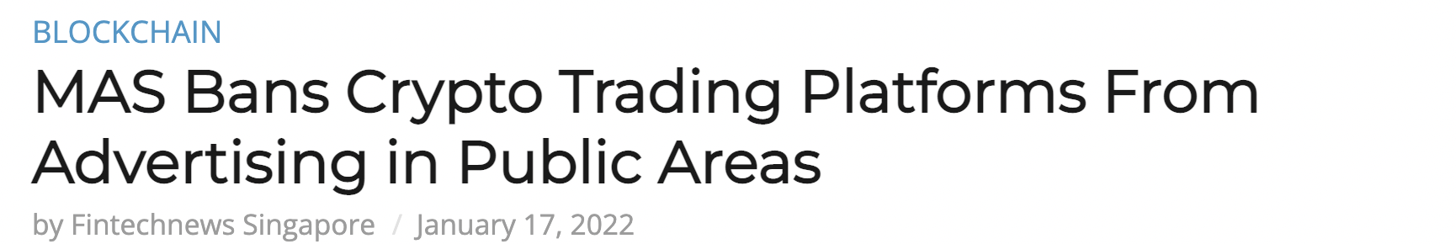
2. Addressable Market
Why target Cryptocurrency Startups?
Cryptocurrency startups face relatively harsh and quickly-changing regulations around the world. Thus, there is a pressing need for these startups to spend resources on ensuring their services are in line with the current government regulations.
TAM: 6032 x ACV
SAM: 1568 x ACV
Notes:
Research on compliance numbers
TAM (Total addressable market) - fintech
SAM (servicable available market) -> the size of the market that the product can reach - crypto/new fintech
SOM (servicable obtainable market) -> the stakeholders that you can reach with current resources
Early evangelists -> you are most likely customers at this current point in time

Slide 5
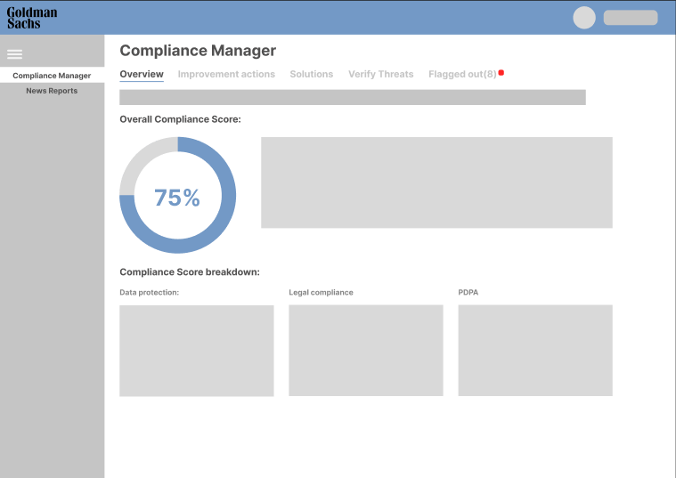
3. Key Features
Flagged out:
An indicator that shows where the client has potentially breached legal areas or their clients have been flagged in Goldman’s internal database. This will be monitored and updated automatically in real-time
Overall Compliance Score:
A weighted average score that measures overall compliance through a series of compliant rules
Verify Threats:
Client is able to meet KYC compliance requirements to minimise risk of financial crimes by verifying customer identities and potential risk

Slide 6
4. Business Use Case
Fintech Company
Compliance Checker
1. Fill in input form of compliance checker
OR
2. Import CSV/excel file with information on customers & 3rd party entities
Conduct automated KYC check using Goldman Sach’s internal database and analytical tools
Structural Checker
Specify relationship between each entity
Conduct automated checks for conflicts in location and service operations
for the fintech company and 3rd party entities
Interface
Flag out high risk entities/ relationships in homepage dashboard
Generate overall risk rating for each entity

Slide 7
5. Success Metrics
Total
Addressable Market
Serviceable
Available Market
Serviceable
Obtainable Market

Slide 8








5. Solution Architecture
Website
React
Static assets stored in EC3
Authenticate
Amazon Cognito
Web Browser
Dynamic API calls over HTTP
API gateway
AWS Lambda
Amazon DynamoDB

Slide 9
6. Scaling our product
MVP:
-Implement KYC and compliance models
-Implement nodal interface to allow for flexible and dynamic updating of entity interactions.
Alpha:
- Increase customizability of compliance assessment templates
- Integrate more APIs and data to provide greater accuracy of compliance score calculation
- Provide suggested solutions for resolving alerts
Beta:
-Expand functionalities to detect potential breaches in data lifecycle management and insider risk management
- Enable compatibility with other third-party compliance management apps and tools
Q4 2022
Q1 2023
Q3 2023
Notes:
MVP - what we currently have
Alpha -
Beta - cybersec solutioning

Slide 10
7. Demo

Slide 11
8. Closing
Implementing this will likely spur growth in the Fintech and Crypto industry as a whole.
Global Fintech market is expected to grow at a CAGR of 23.58% from 2021 to 2025.
This growth in the Fintech market, especially the Cryptocurrency market, will consequently lead to increase in trust in these new companies and technologies.
This increased trust will attract venture capital, further contributing to a growing market that Goldman Sachs can leverage its substantial experience to capitalize on.

Slide 12
9. References
https://risk.lexisnexis.com/global/en/insights-resources/research/true-cost-of-financial-crime-compliance-study-global-report
https://www.forbes.com/sites/servicenow/2021/10/21/the-creeping-cost-of-compliance/?sh=6d0ef5e456cc
https://docs.microsoft.com/en-us/microsoft-365/compliance/compliance-manager?view=o365-worldwide
https://spdload.com/blog/fintech-compliance/

Slide 13

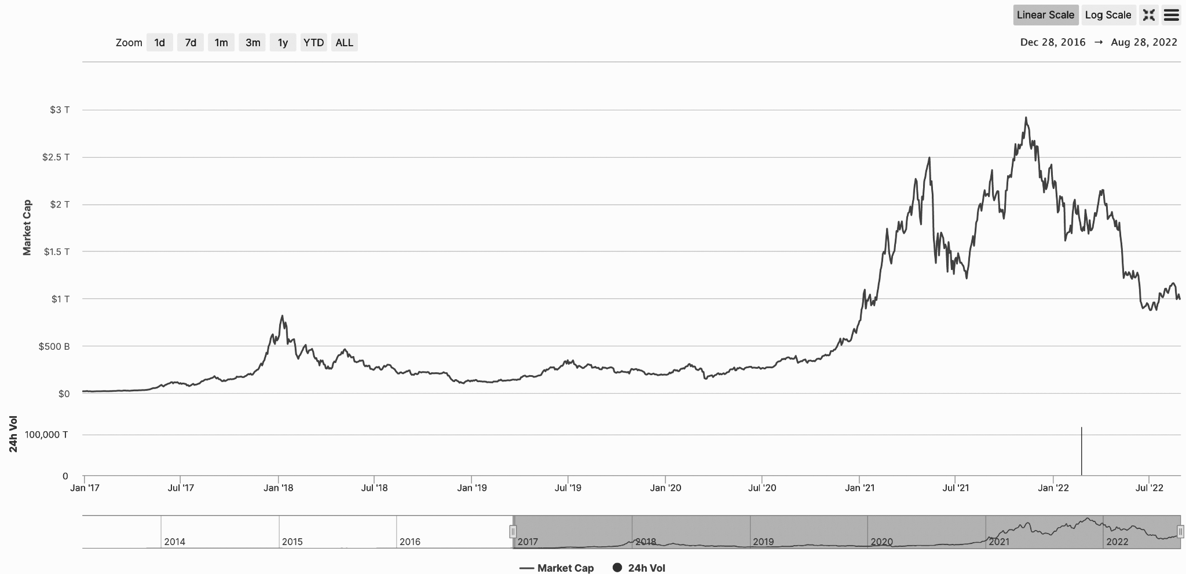
2. Addressable Market
Between January 2017 and August 2022, total Cryptocurrency market capitalization has increased from US$17 billion to just under US$1 trillion, or an increase of roughly 5533%.
Q1 2022 alone, crypto startups raised a record sum of money, with 28 investment rounds being worth $100 million or more. (source: https://venturerocket.vc/news)
Total
Crypto Market Cap, sourced from https://coinmarketcap.com/

Slide 14


1. Problem Statement
Key Pain Points
Government intervention remains the biggest threat to fintech start-up’s survival. Crypto start-ups need to ensure their platform isn’t used for illegal purposes.
Problem Statement
This causes many crypto start-ups to unintentionally breach government regulations or allowing their platform to be used for illegal purposes.
Crypto start-ups do not view complying with regulations as a priority as they often choose to invest time, effort and money into scaling their business instead.
Notes:
This is a daily operational occurrence but increases in call complexity related to changes in the knowledge base – multiple programs and changes in the environment (client demographics and needs/circumstances, legislation, etc.) – have resulted in an increase in severity and stress on the system.

Slide 15
1. Problem Statement
Problems of Compliance Process for Fintech Companies
Compliance is a indispensable process for companies offering financial services.
Yet, compliance can also be immensely overwhelming and challenging for companies like fintech startups.
1. Tedious & Error-prone
Regulations for fintech companies are constantly updating across various geographical regions and business sectors.
2. Huge Financial & Time Costs
Regular monitoring by staff with sufficient expertise entails huge financial costs.
Prolonged operational time is also undesirable in this competitive market where speed can be pivotal.
3.
Non-compliance can be detrimental for fintech companies: fines, penalties, and loss of consumer base can significantly cripple operations and growth.
Notes:
This is a daily operational occurrence but increases in call complexity related to changes in the knowledge base – multiple programs and changes in the environment (client demographics and needs/circumstances, legislation, etc.) – have resulted in an increase in severity and stress on the system.

